Slide 1
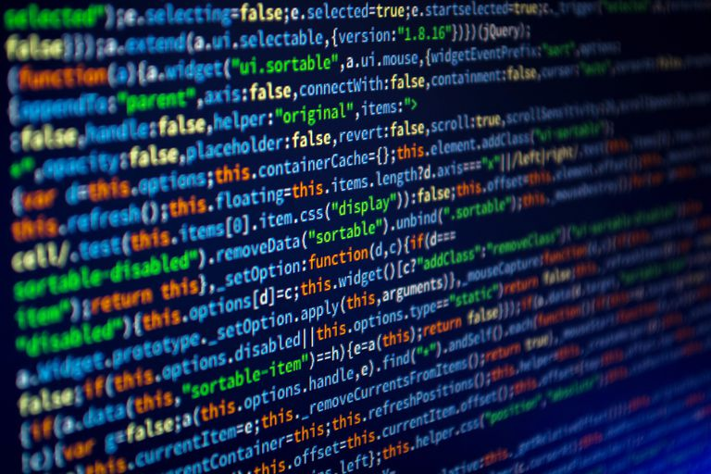
JavaScript Concepts
Hyland Tech Outreach

Slide 2
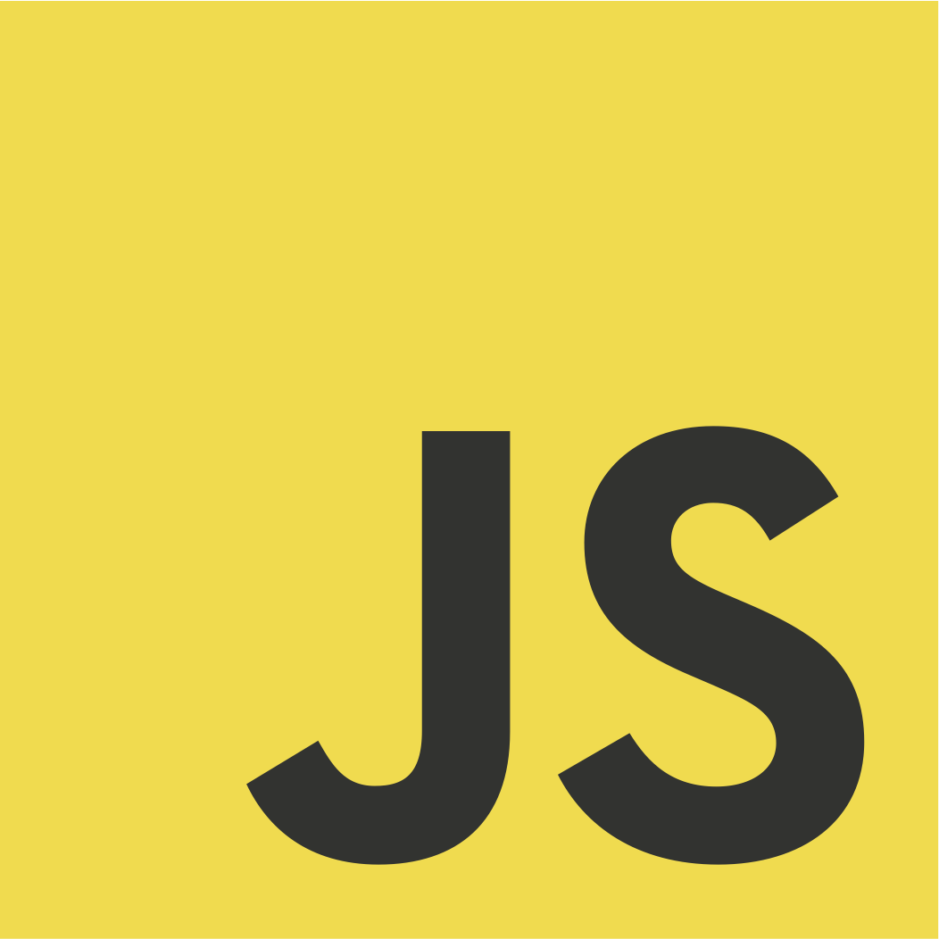
JavaScript is the programming language of the web.
It makes websites interactive.
Developers use JavaScript to:
trigger events
create animations
make games
much more!
Notes:
Start off by asking the question – what is JavaScript?
Explain that JavaScript is the programming language of the web. Almost every modern website uses some JavaScript, so most of the students have probably interacted with it whether they know it or not.
JavaScript is what makes websites interactive.
There are a bunch of things JavaScript can do!

Slide 3
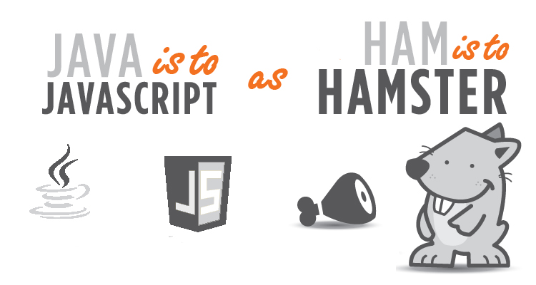
Notes:
Explain that JavaScript and Java are not the same thing, even though they are both programming languages and use some of the same syntax!

Slide 4
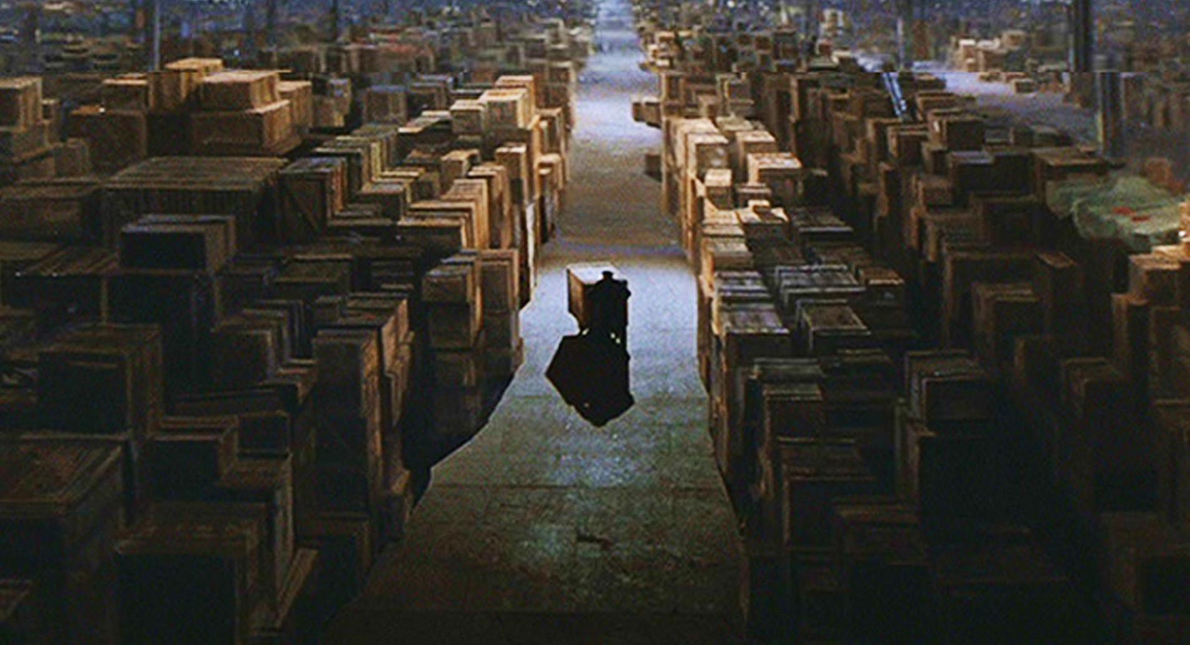
Variables
Notes:
Think of a computer’s memory as a giant warehouse. If memory is a giant warehouse...
…then a block of memory is the box
...and a value is the contents of a box
...and a variable is a label you stick on the outside of the box

Slide 5
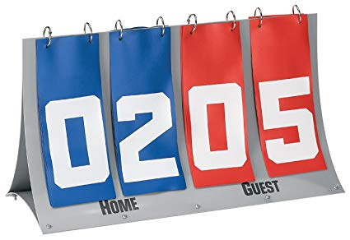
Variables Example
var bluePoints = 2;
var redPoints = 5;
bluePoints++;
Notes:
Explain that variables are something the computer tracks. They all have names and values. For example, think of a scoreboard. There are two variables that track the number of points each team has. Developers set a variable with the equals sign. Setting these variables is like putting a label on a box, and putting the number in the box.<click>
Ask the students what the score will be after the value of bluePoints is incremented with ++

Slide 6
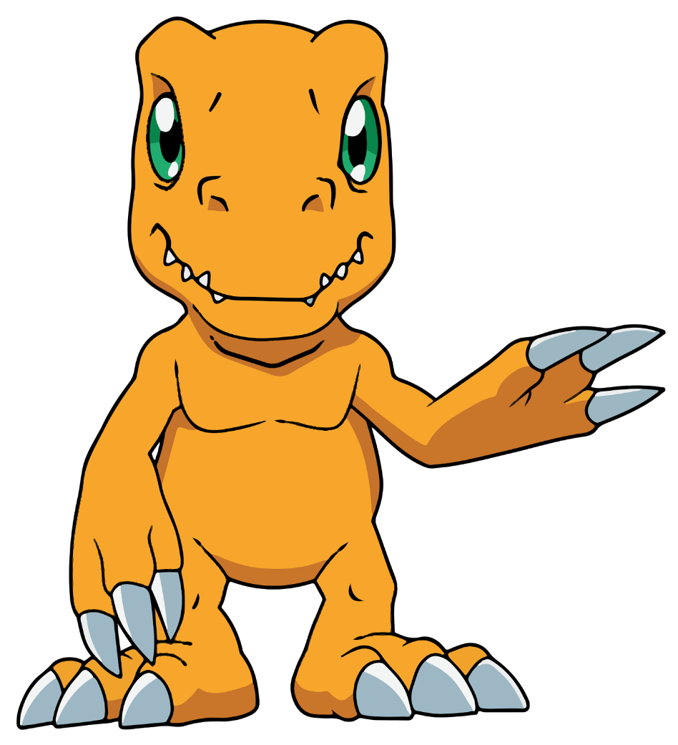
Variables Example 2
var yourName = "Alex"; alert("Hello " + yourName);
Hello Alex
Notes:
Variables don’t only store numbers though, they can also store text! In this example, we’re using an alert with a variable and some other text. This is like putting yourName as a label on the box, then putting in “Alex.”
Ask the students what they think the alert will do. Ask them what message the user will see. <click>

Slide 7
Variables Example 3
var name = prompt("What's your name?");
alert("Hello " + name);
Hello Tracy
Hello Jaime
Hello Robin
Notes:
In JavaScript, it is also possible to ask questions to the user. Then, based on the answer, the program can do something different! With prompt, the user’s answer is stored in the variable (in this example, the name variable). This is like putting a label of name on a box, and then letting the user put in their own value!
Ask the students what they think the alert will do… it will depend what the user enters!
If the user says “Tracy,” the program will say “Hello Tracy.” <click>
What will it say if the user enters “Robin?” <click>
What about “Jaime?” <click>

Slide 8
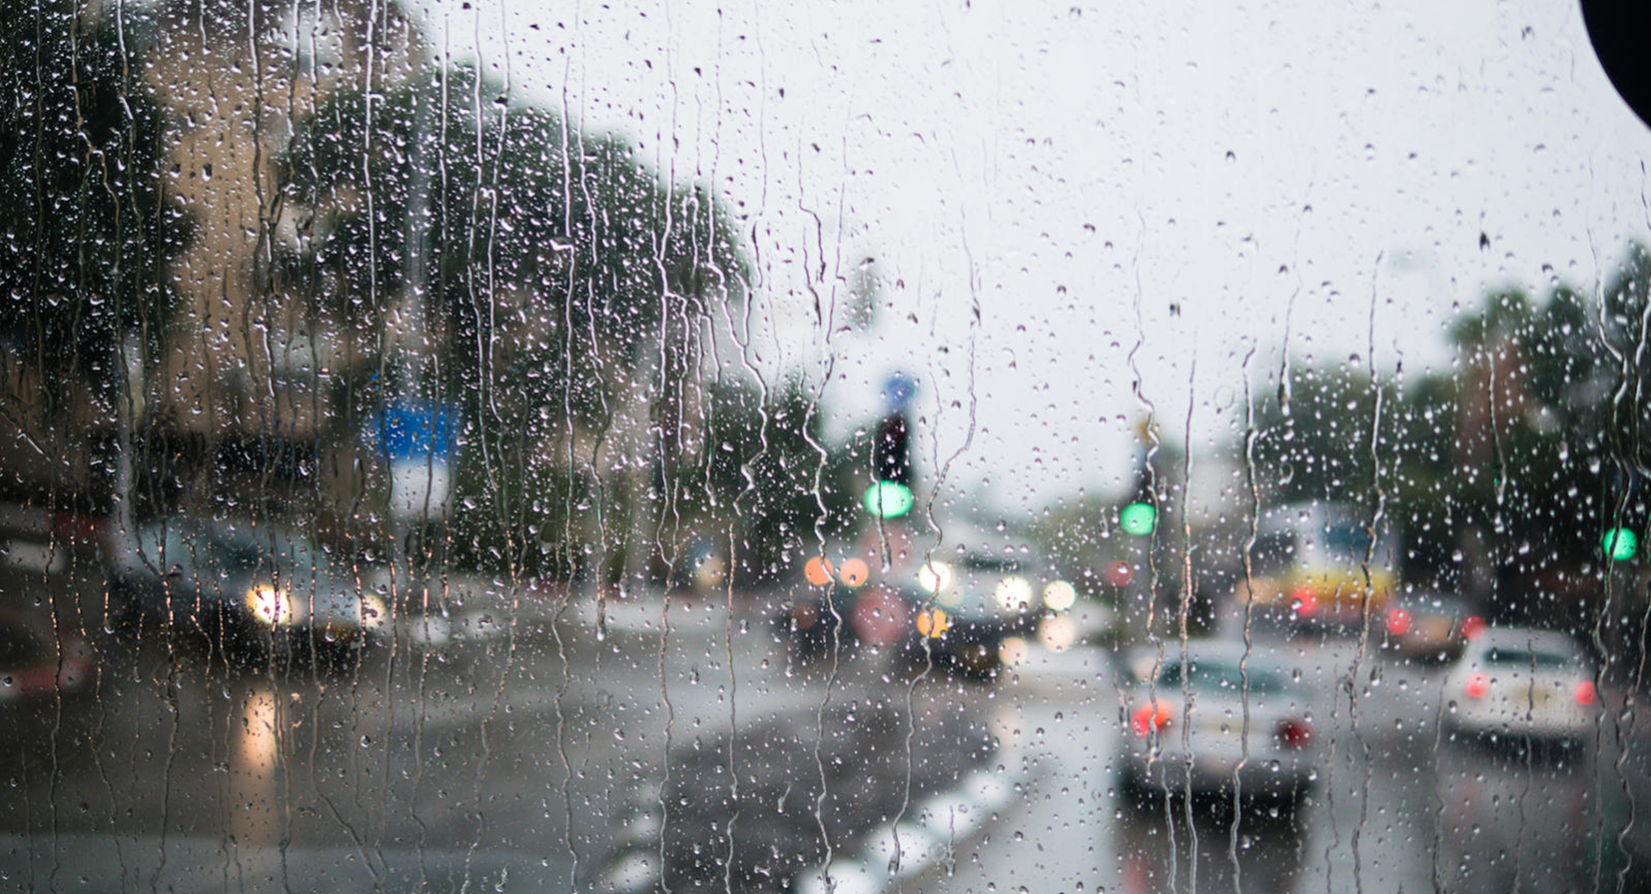
If Statements
Notes:
If statements allow you to do different things depending on conditions. It’s just like in English. Ask the students what “if” means in English.
For example, if it is raining, then ??? (ask the students what they do if it is raining. Possible answers: you stay inside, you get an umbrella, you say “oh no”)

Slide 9


If Statement Example
var weather = "Rainy";
if (weather == "Rainy") {
alert("Stay inside!");
}
"Sunny";
y”
Notes:
If statements are a powerful way to change what happens in the program. For example, a developer may want the program to say something only if the weather is rainy.
Developers use a double-equals sign to compare two values. This will lead to a true or false value; it will be true if the two things are equal, and false otherwise.
Ask the students what message the user will see. It should say “Stay inside!” <click>
If the weather variable was “Sunny” instead of “Rainy,” what message would the user see? Ask the students. The answer is no message at all!

Slide 10
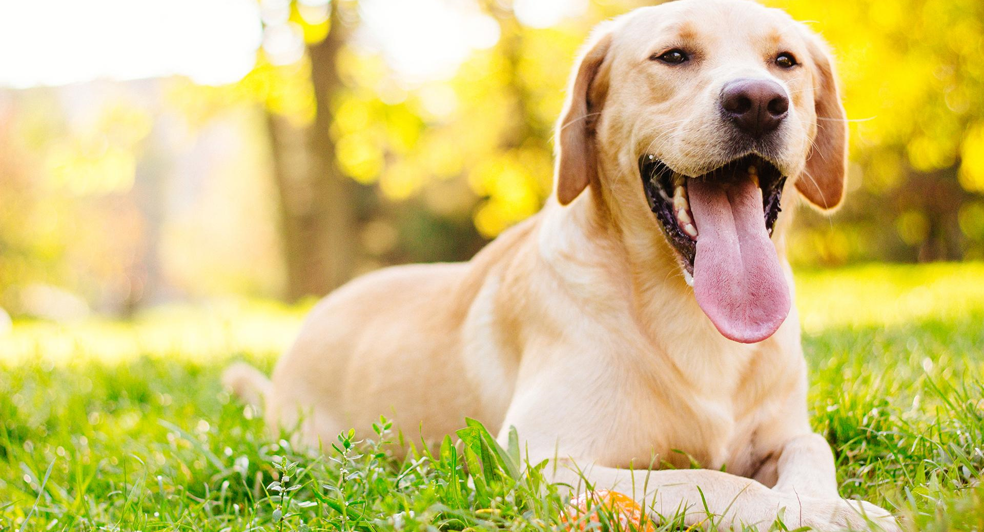
Functions
Notes:
Functions are kind of like commands you would give to your dog. You tell your dog to sit, and they know what to do! In JavaScript, commands to different things, like show messages.
Ask the students if they can think of any functions they have already seen. alert is a function, and so is prompt.

Slide 11
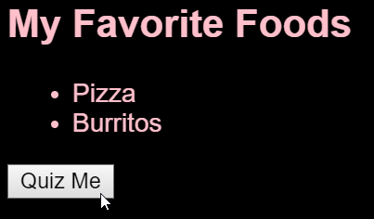
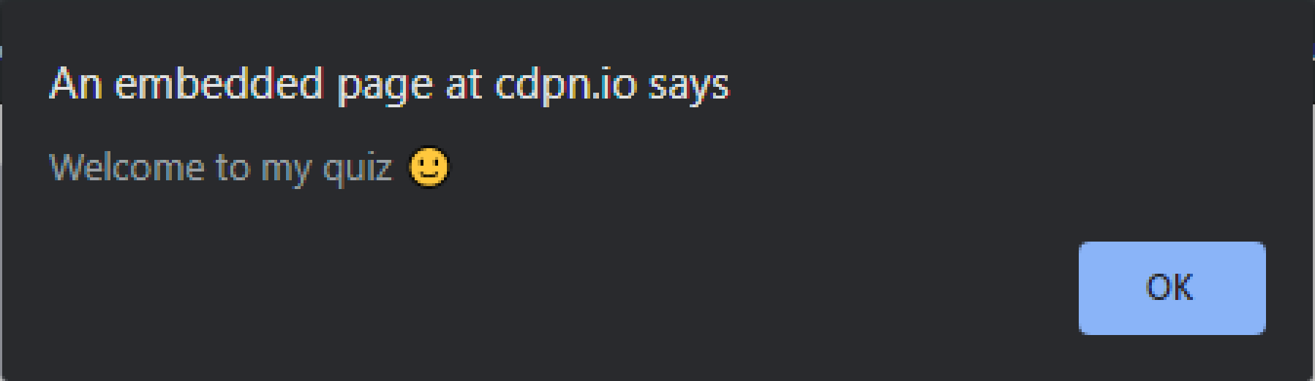
Buttons call functions
<button onclick="startQuiz()">Quiz Me</button>
Notes:
In HTML, there is a button that says “Quiz Me.” The onclick is set to call the startQuiz function. When the user clicks that button, it starts the quiz! It runs some code that shows the message.

Slide 12

Developers Define Functions
function startQuiz() {
alert("Welcome to my quiz 🙂");
}
Notes:
Defining a function allows a developer to specify what will happen when the function is called. For example, when the user clicks the button, it will execute this code. This code will only execute if it is called. Because the onclick on the button is set to startQuiz(), it will run this code and use the alert to show a message to the user.
<click> This is like teaching your dog a trick. It knows what to do when you say to start the quiz!
NOTE: Open the Emoji Keyboard on Windows by holding the Windows key and then pressing the colon key

Slide 13
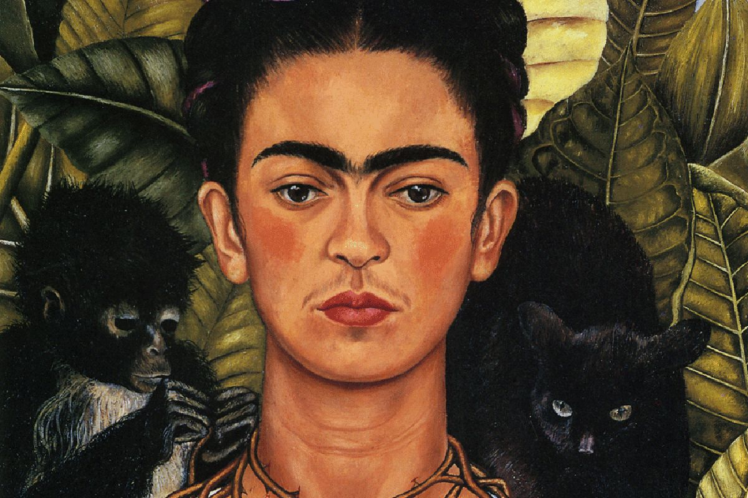
Self-portrait in code unplugged Activity
Notes:
Ask the students if they know who Frida Kahlo is – she is famous for her self-portraits!

Slide 14
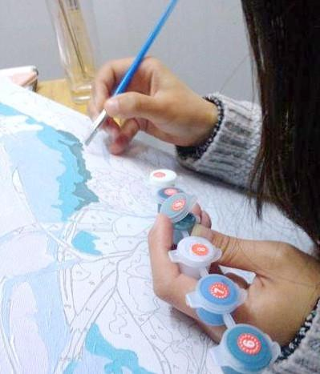
Background
An algorithm is a series of specific instructions that solve a problem or achieve a goal. A step-by-step recipe or a paint-by-numbers picture are examples of algorithms!
Pseudocode is fake code–a way to plan a computer program using human-friendly language instead of a computer language like JavaScript.
We will use pseudocode to write a self-portrait algorithm!
Notes:
Explain algorithms and pseudocode, and that we will be doing an activity to write some pseudocode that would tell a computer how to draw… but first we need to learn a little more about JavaScript syntax.

Slide 15
Pseudocode JavaScript Functions
drawHair();
Function Syntax
Name – no spaces, no special characters (except underscores)
Numbers are allowed, but not as the first character in the function
Parentheses – tells JavaScript to run the function
Semi-colon – shows that the statement has ended (like punctuation)
Notes:
For pseudocode, we can pretend that the computer can do anything we want. For example, all we have to do is say “drawHair();” and it will know how to draw some hair.
drawHair tells the “computer” to draw hair!

Slide 16
Mini Quiz! Are these proper JavaScript function calls?
Notes:
For each function call, ask students if the syntax is correct. Call on students individually, randomly, using pop-corn, going down the rows, or as a group allow them to answer yes or no.

Slide 17
1st_eye();
Notes:
This doesn’t work, because it starts with a number

Slide 18
drawBlueEyes();
Notes:
This works!

Slide 19
makeCake;
Notes:
This doesn’t work because there are no parentheses

Slide 20
chocolate_cake();
Notes:
This works!

Slide 21
draw ear()left;
Notes:
This does not work because it does not end with parentheses, and there is a space

Slide 22
cook-rice();
Notes:
This does not work because it does not end with parentheses, and there is a space

Slide 23
paintNails();
Notes:
This works!

Slide 24
Write pseudocode to draw a self-portrait
Open Notepad
Write code to call functions, with each function on its own line
Remember, the computer can do anything… as long as the syntax is right!
EXAMPLE
useMarker();
drawFace();
drawEye();
drawEye();
drawNose();
drawSmile();
EXAMPLE
drawHead();
drawBlueHair();
drawGlasses();
drawRedShirt();
drawJeans();
EXAMPLE
sketchFace();
colorGreenEyes();
drawEarrings();
placeHeadband();
drawDress();
paintDressGreen();
drawShoes();
Notes:
Encourage the students to be creative! Give them 5 minutes to write their algorithms.

